Slide 1
Solving the Iterative Learning Control Problem with Reinforcement Learning in a Conjugate Basis Space
March 11, 2025
An Honors Thesis in Engineering Sciences
Thayer School of Engineering at Dartmouth College
By Noah Dunleavy
Under Advisement of Professor Minh Q. Phan

Slide 2
A Quick Intro to Modern Control Theory

Slide 3
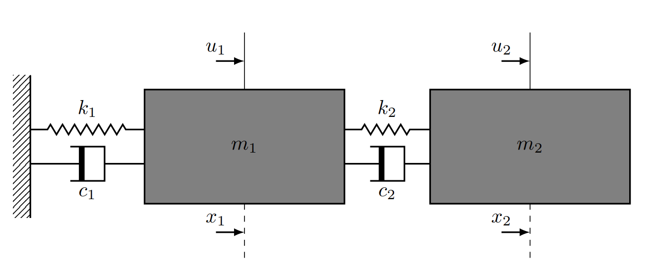
Our System
Notes:
This is the system which we will be working with throughout the entire presentation, but the logic applies for any system. We have two masses which we can apply inputs u1 and u2 to, and we measure their positions as our output

Slide 4



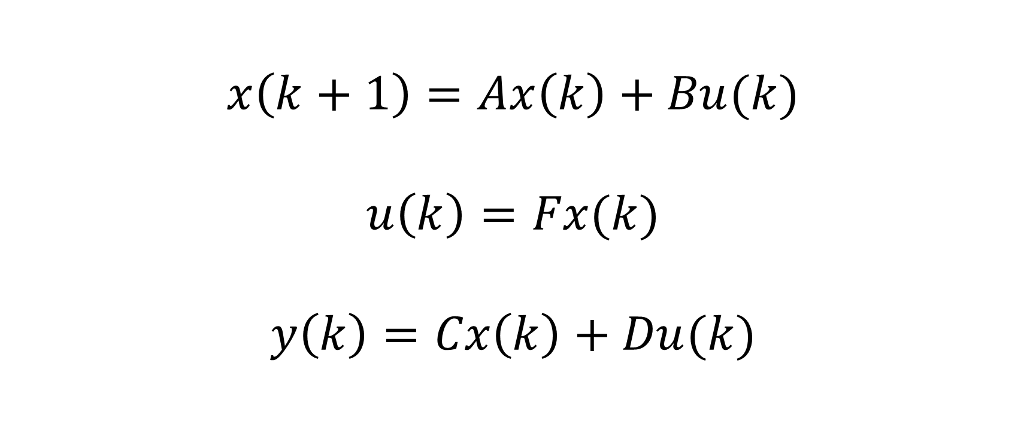













Discrete State-Space
$$n×n$$
$$4×4$$
$$n×r$$
$$4×2$$
$$4×1$$
$$n×1$$
$$x\left(k+1\right)=Ax\left(k\right)+Bu(k)$$
$$u\left(k\right)=Fx(k)$$
$$y\left(k\right)=Cx\left(k\right)+Du(k)$$
$$r×1$$
$$2×1$$
$$2×4$$
$$r×n$$
$$m×1$$
$$2×1$$
$$m×n$$
$$2×4$$
$$m×r$$
$$2×1$$

Slide 5
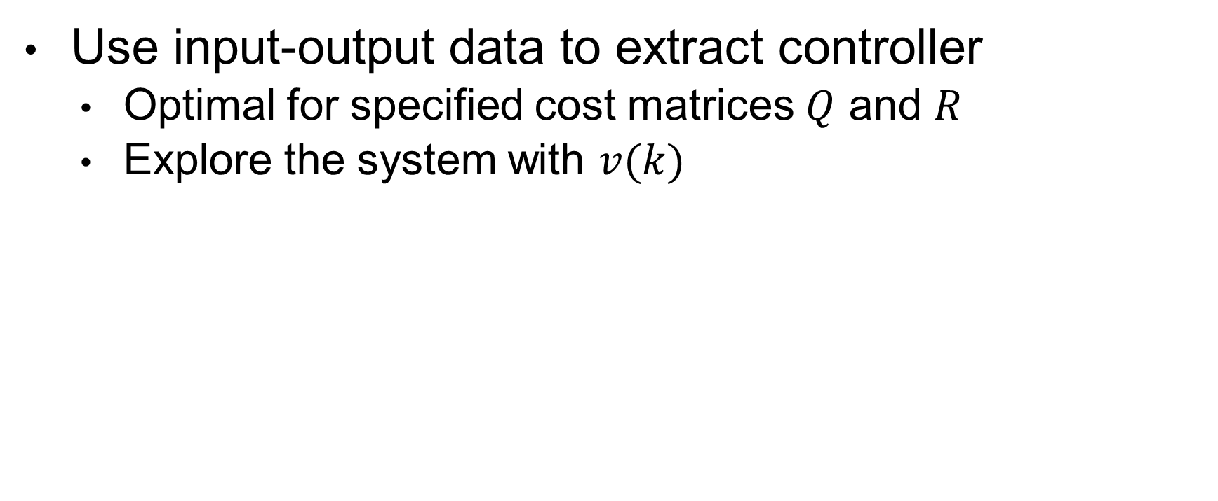
Reinforcement Learning (RL)
Use input-output data to extract controller
Optimal for specified cost matrices $Q$ and $R$
Explore the system with $v(k)$
Notes:
All these techniques are nice, but they require knowledge on our ABCD matrices. To construct an LQR controller without any system information, we can use reinforcement learning.

Slide 6
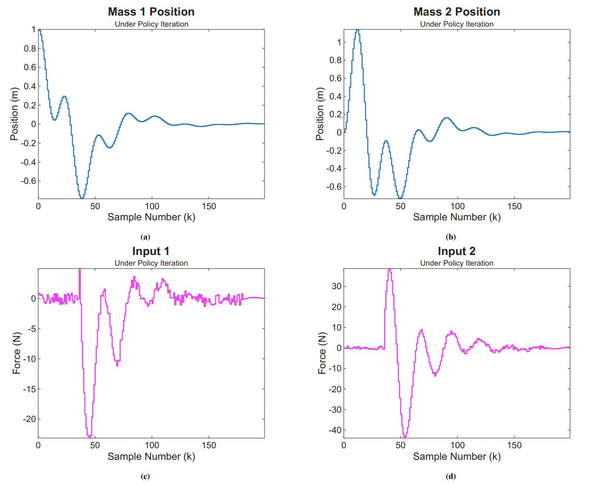
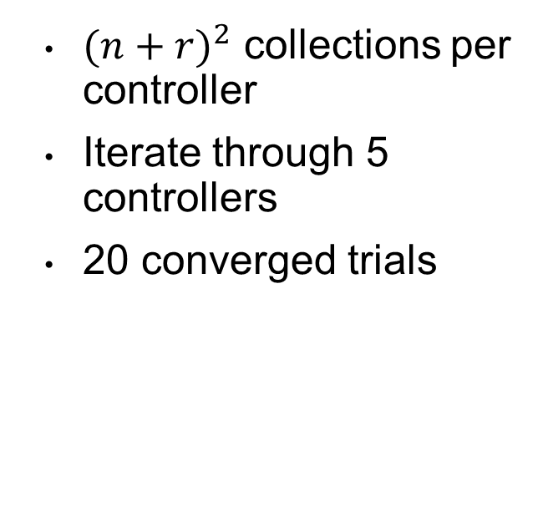
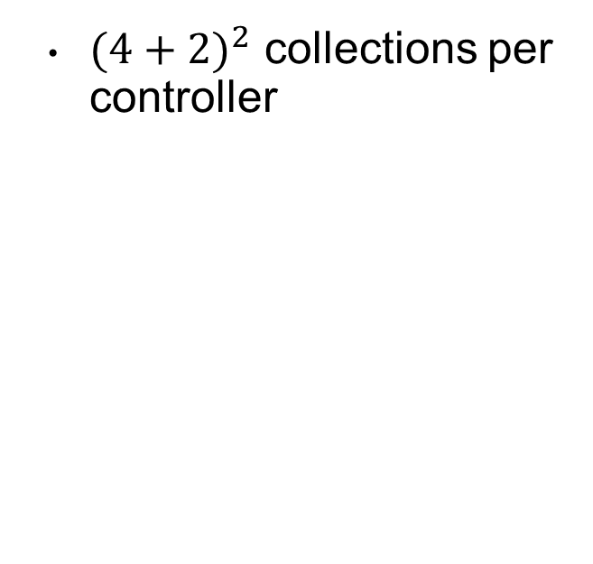
Policy Iteration
${(4+2)}^{2}$ collections per controller
${(n+r)}^{2}$ collections per controller
Iterate through 5 controllers
20 converged trials

Slide 7
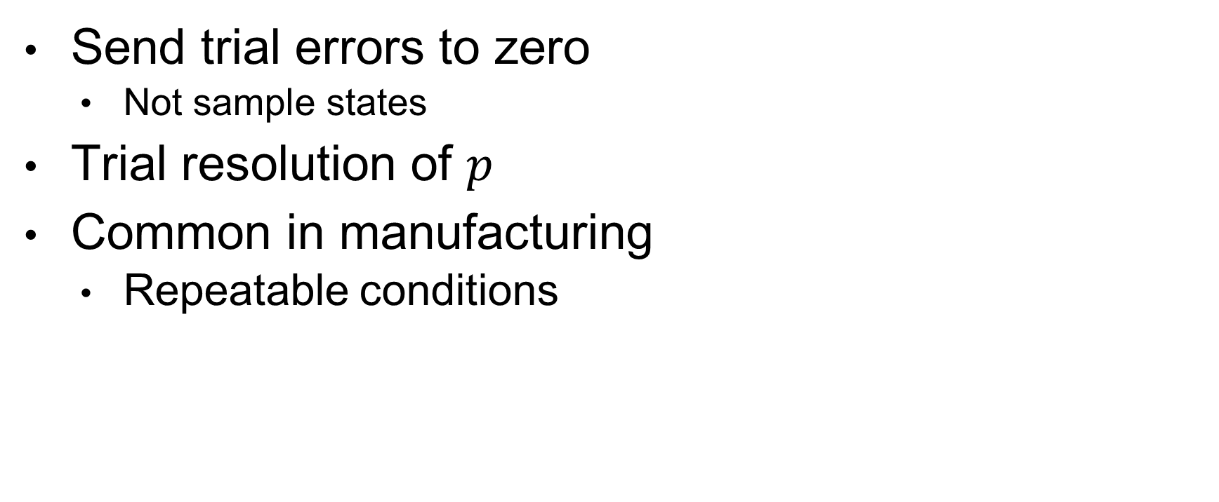
Iterative Learning Control (ILC)
Send trial errors to zero
Not sample states
Trial resolution of $p$
Common in manufacturing
Repeatable conditions
Notes:
Intro

Slide 8
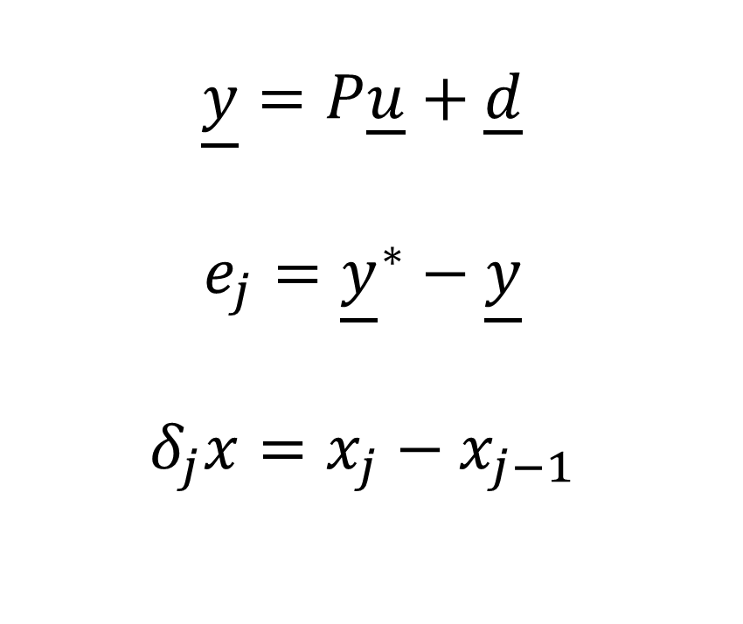
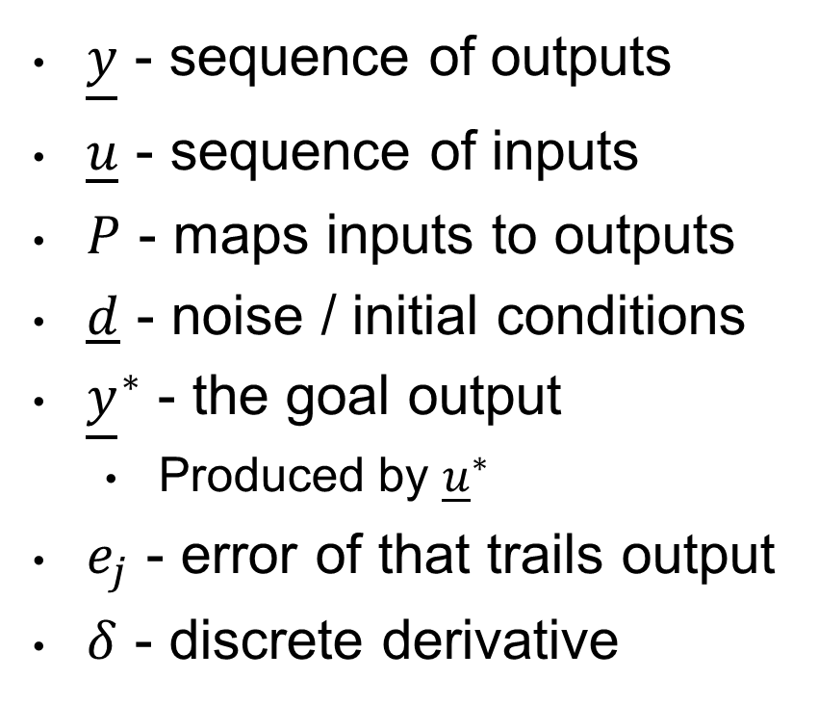
The ILC System Construction
$\underline{y}$ - sequence of outputs
$\underline{u}$ - sequence of inputs
$P$ - maps inputs to outputs
$d$ - noise / initial conditions
${\underline{y}}^{∗}$ - the goal output
Produced by ${\underline{u}}^{∗}$
$e_{j}$ - error of that trails output
$δ$ - discrete derivative
$$\underline{y}=P\underline{u}+\underline{d}$$
$$e_{j}={\underline{y}}^{∗}−\underline{y}$$
$$δ_{j}x=x_{j}−x_{j−1}$$

Slide 9


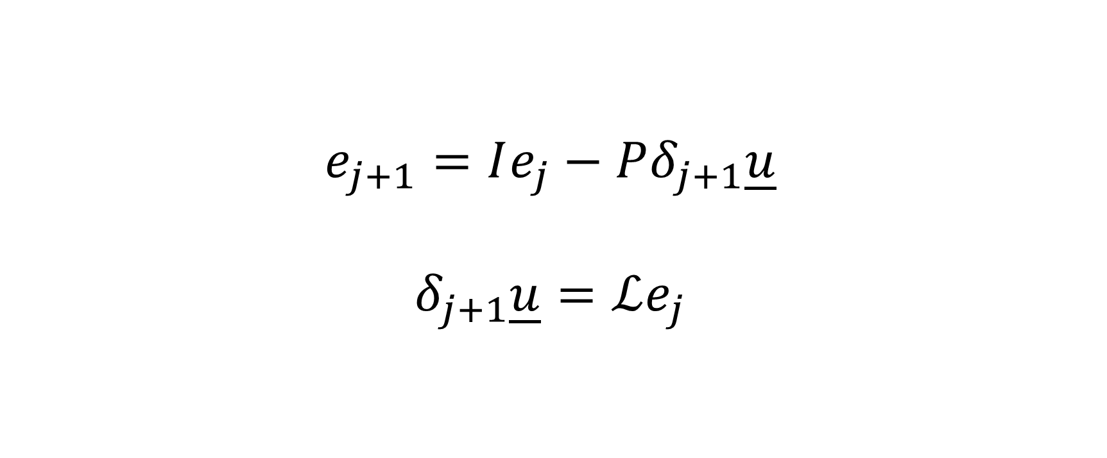



The ILC System
$$e_{j+1}=Ie_{j}−Pδ_{j+1}\underline{u}$$
$$δ_{j+1}\underline{u}=ℒe_{j}$$
$$pm×1$$
$$pm×pr$$
$$pm×1$$
$$pr×1$$
$$pr×pm$$

Slide 10
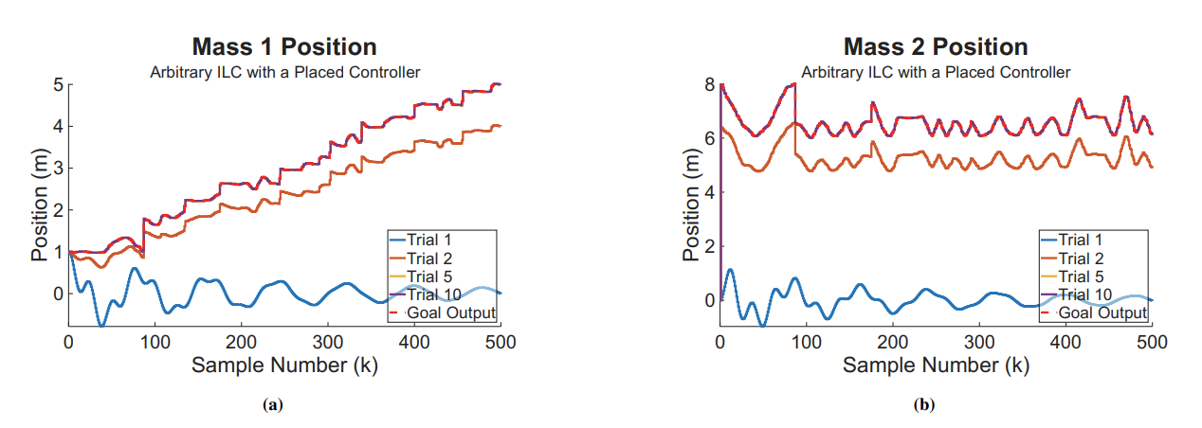
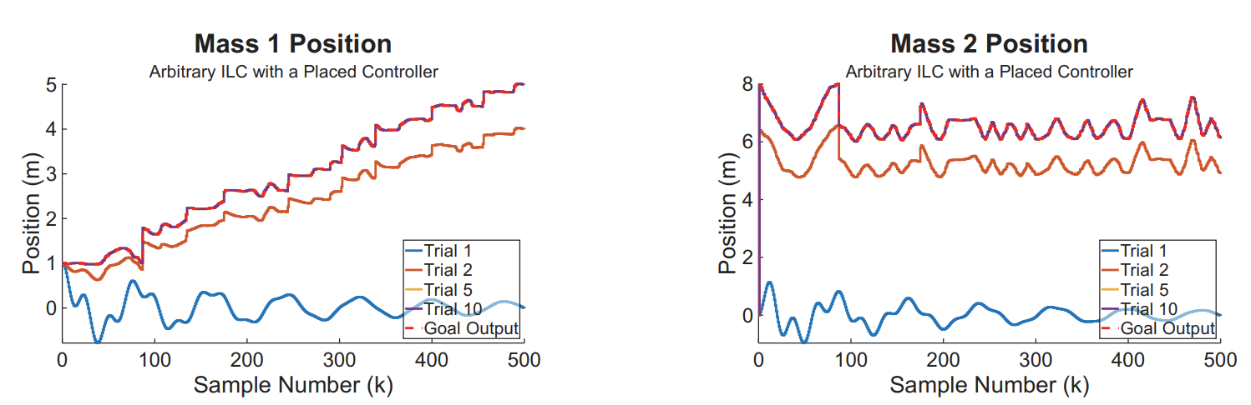
Arbitrary Shapes

Slide 11
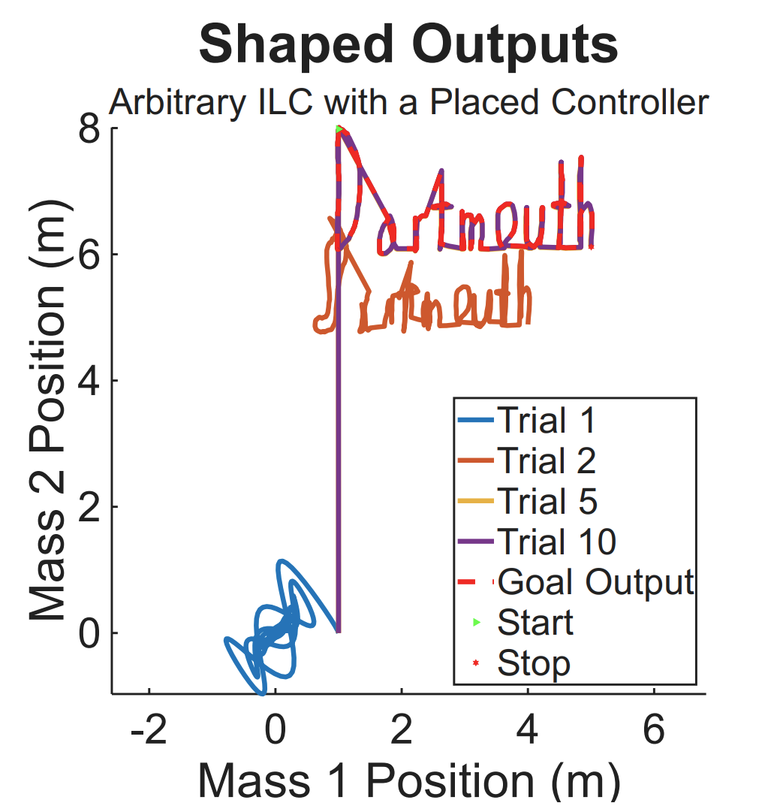

Slide 12
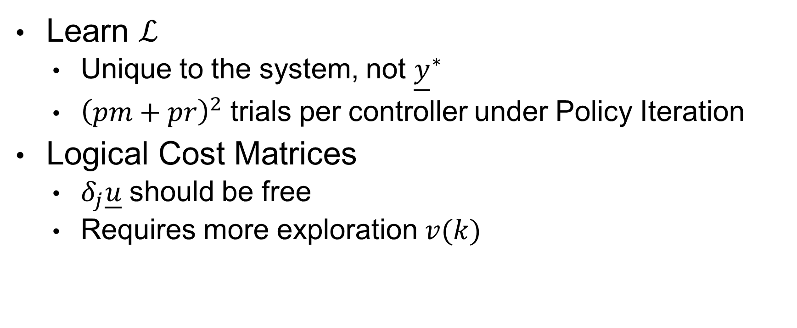
RL on ILC
Learn $ℒ$
Unique to the system, not ${\underline{y}}^{∗}$
${\left(pm+pr\right)}^{2}$ trials per controller under Policy Iteration
Logical Cost Matrices
$δ_{j}\underline{u}$ should be free
Requires more exploration $v(k)$

Slide 13
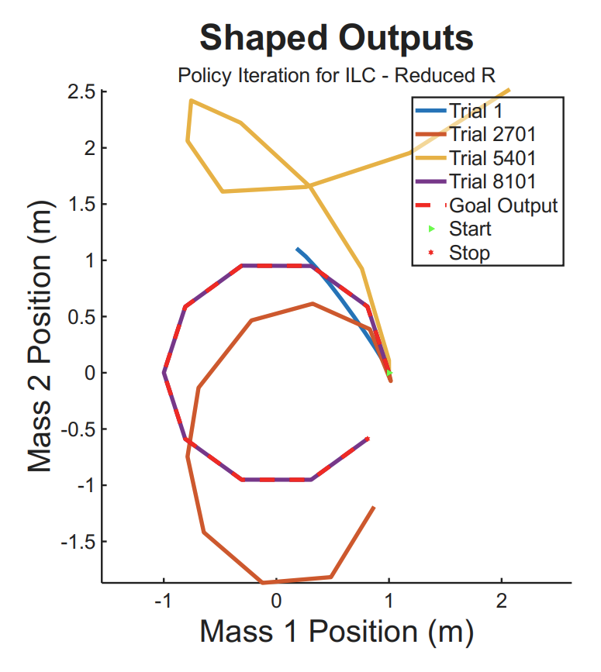
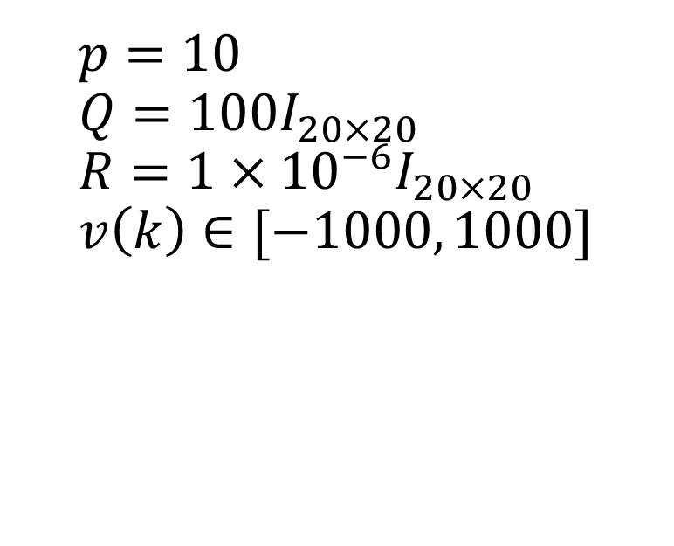
Small Shapes
$p=10$
$$Q=100I_{20×20}$$
$$R=1×{10}^{−6}I_{20×20}$$
$$v\left(k\right)∈[−1000, 1000]$$

Slide 14
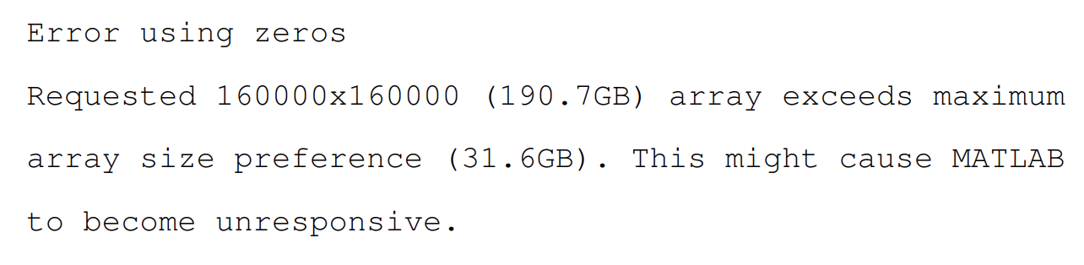
Big Shapes

Slide 15
The Problem
The Iterative Learning Control Problem scales the number of effective ‘states’ and ‘inputs’ for a given system, exponentially increasing the data needed for the application of Reinforcement Learning to solve model-free problems - rendering it both monetarily and computationally impractical.
Notes:
Problem statement

Slide 16
Methods and Experimentation

Slide 17
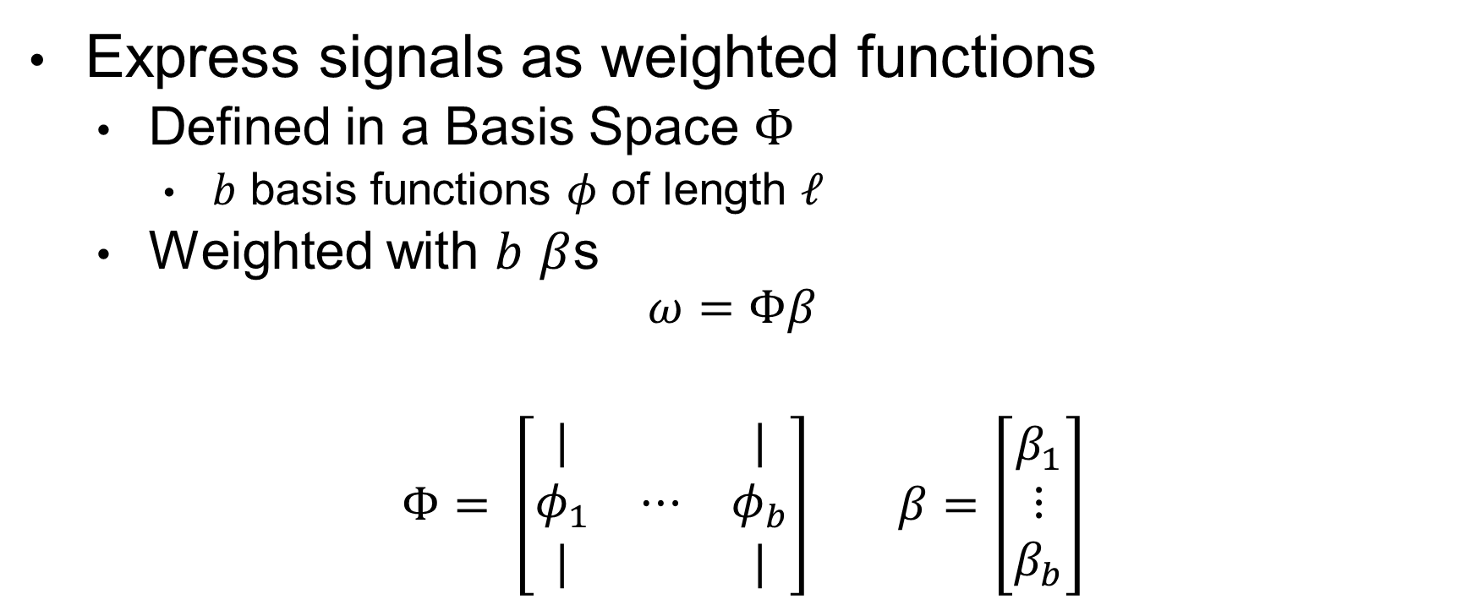
Basis Functions
Express signals as weighted functions
Defined in a Basis Space $Φ$
$b$ basis functions $φ$ of length $ℓ$
Weighted with $b$ $β$s
$$ω=Φβ$$
$Φ= \left[\begin{matrix}| & & | \\ φ_{1} & ⋯ & φ_{b} \\ | & & |\end{matrix}\right]$ $β=\left[\begin{matrix}β_{1} \\ ⋮ \\ β_{b}\end{matrix}\right]$

Slide 18
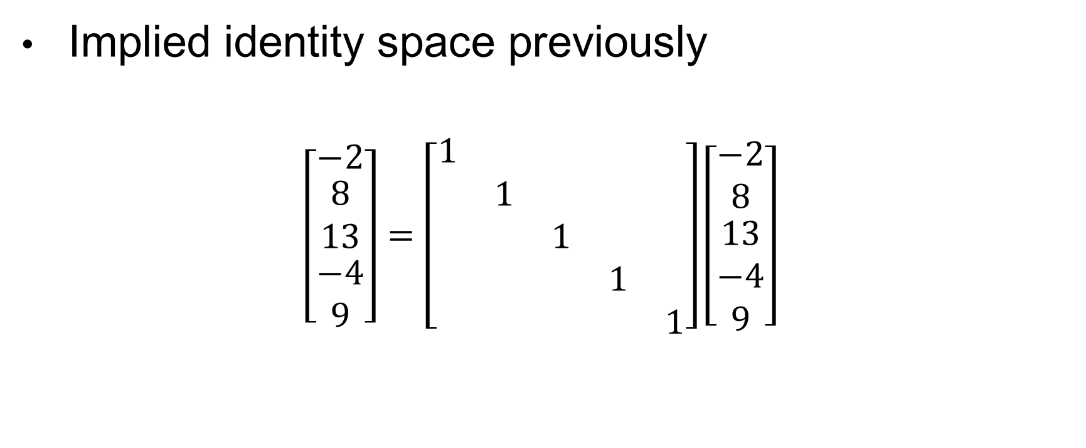
Basis Functions
Implied identity space previously
$$\left[\begin{matrix}−2 \\ \begin{aligned}8 \\ 13\end{aligned} \\ −4 \\ 9\end{matrix}\right]=\left[\begin{matrix}1 & & & & \\ & 1 & & & \\ & & 1 & & \\ & & & 1 & \\ & & & & 1\end{matrix}\right]\left[\begin{matrix}−2 \\ 8 \\ \begin{aligned}13 \\ −4 \\ 9\end{aligned}\end{matrix}\right]$$

Slide 19
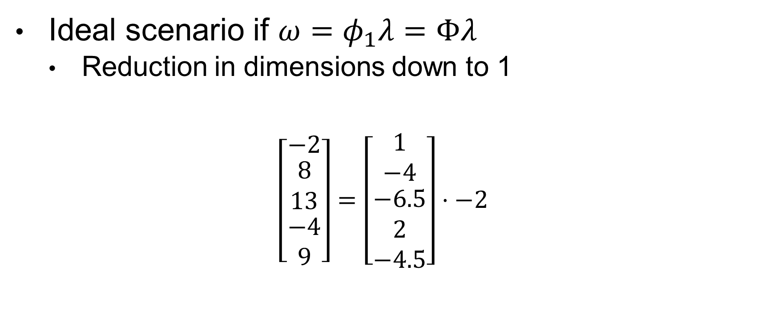
Basis Functions
Ideal scenario if $ω=φ_{1}λ=Φλ$
Reduction in dimensions down to 1
$$\left[\begin{matrix}−2 \\ \begin{aligned}8 \\ 13\end{aligned} \\ −4 \\ 9\end{matrix}\right]=\left[\begin{matrix}1 \\ −4 \\ \begin{aligned}−6.5 \\ 2 \\ −4.5\end{aligned}\end{matrix}\right]⋅−2$$

Slide 20
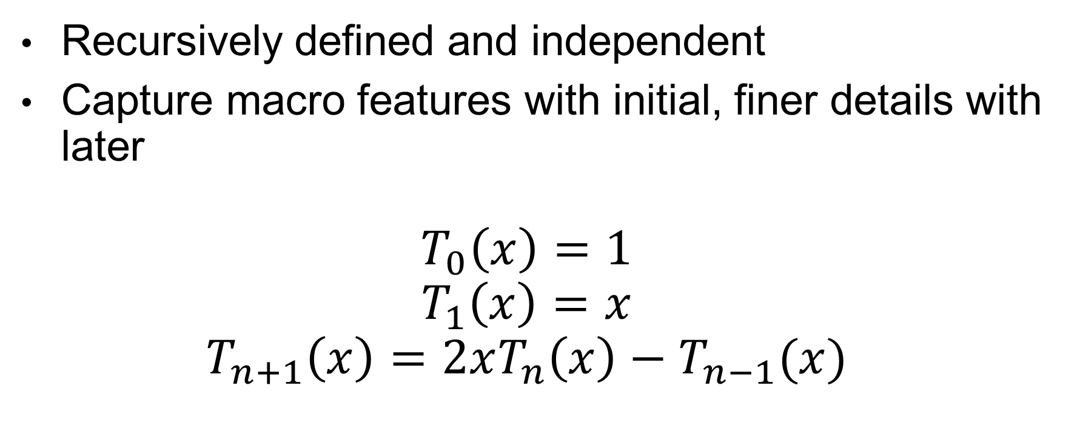
Chebyshev Polynomial
Recursively defined and independent
Capture macro features with initial, finer details with later
$$T_{0}\left(x\right)=1$$
$$T_{1}\left(x\right)=x$$
$$T_{n+1}\left(x\right)=2xT_{n}\left(x\right)−T_{n−1}(x)$$

Slide 21
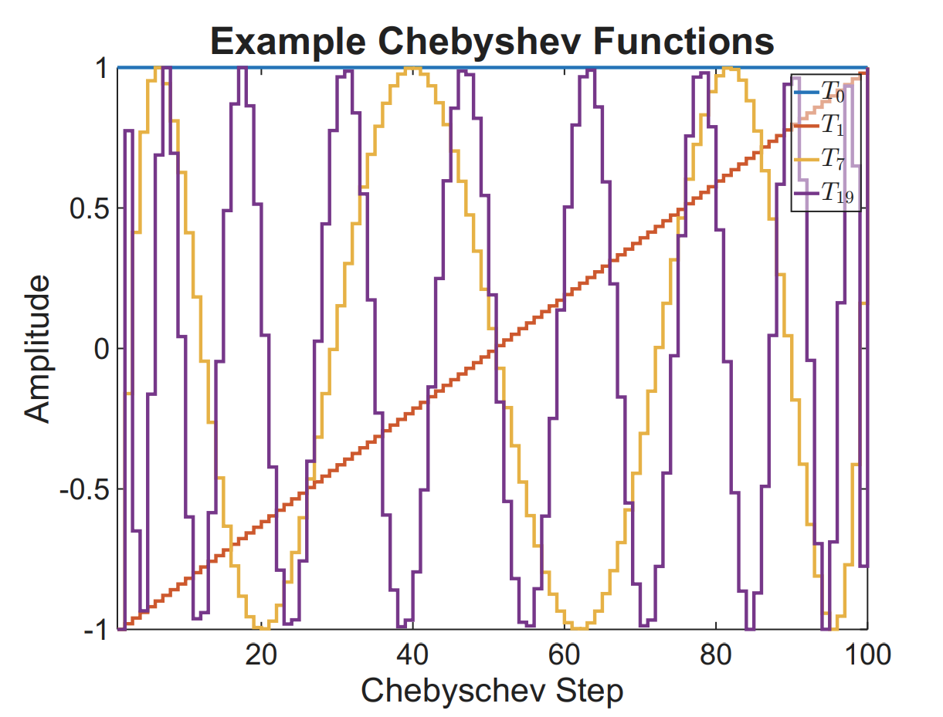

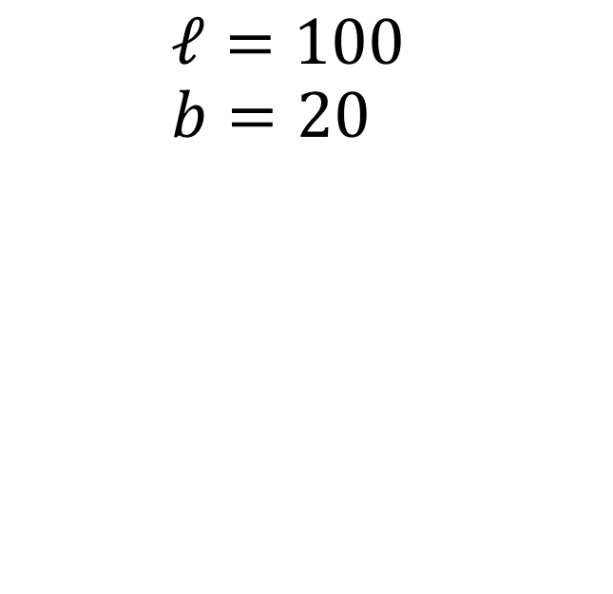
$Φ$ from Chebyshev
$$ℓ=100$$
$$b=20$$

Slide 22
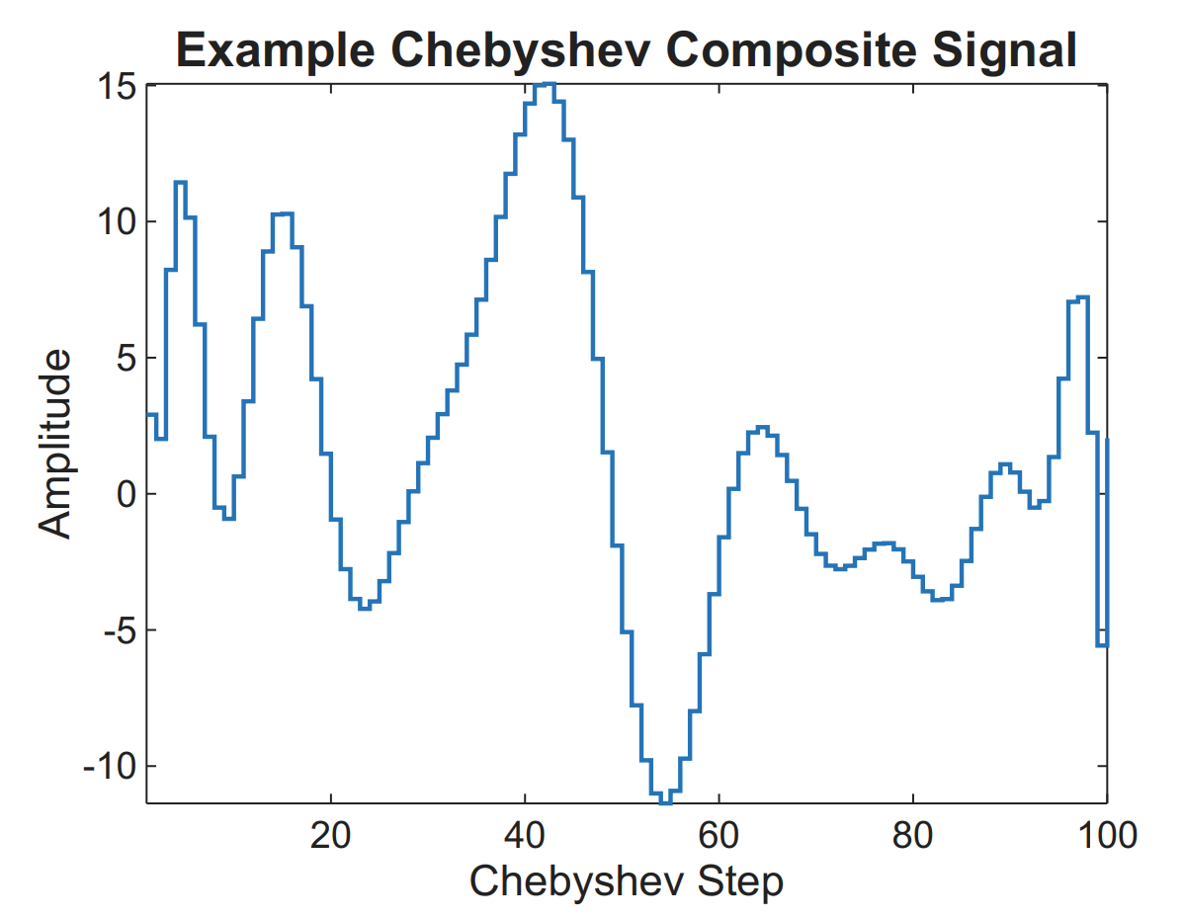
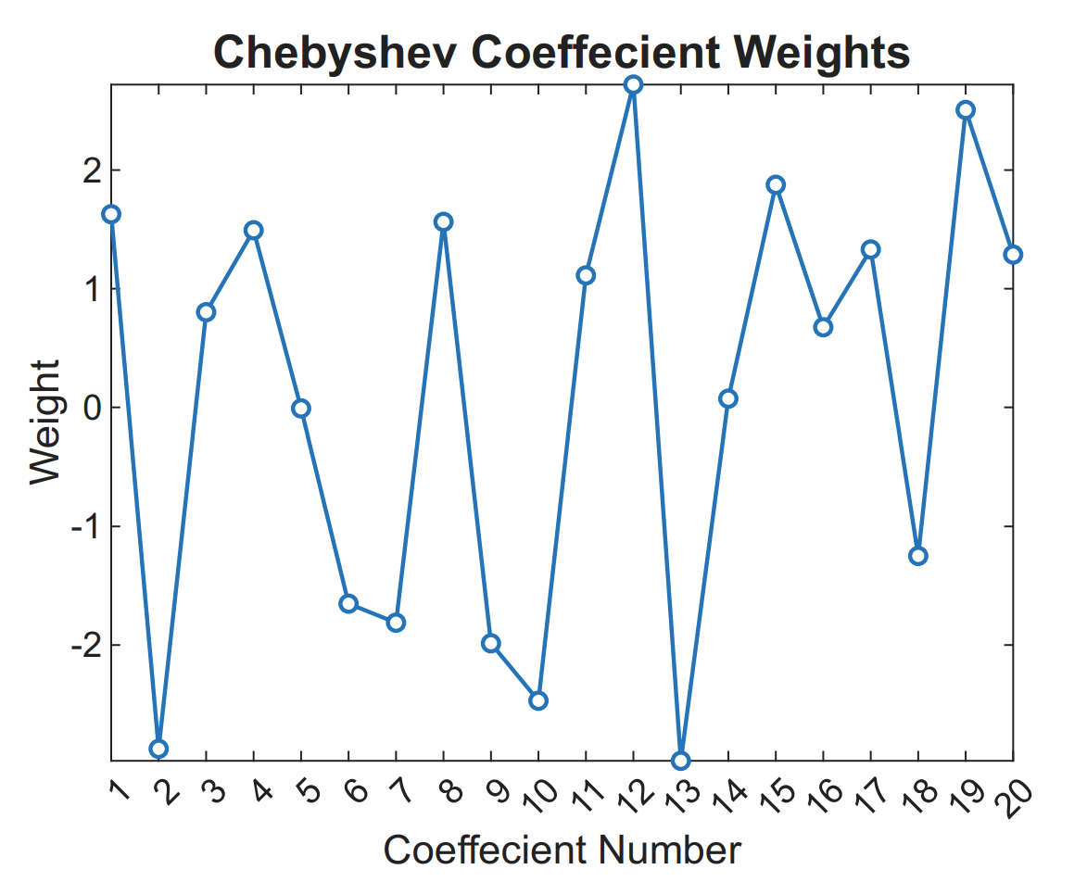



$$ω=Φβ$$
$$ω$$
$$β$$

Slide 23
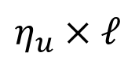
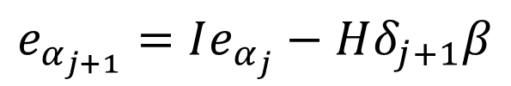
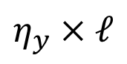

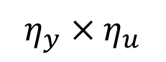
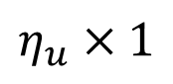
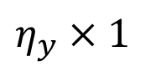
Redefining our ILC Problem in a Basis Space
$$η_{y}×ℓ$$
$$η_{u}×ℓ$$
$\underline{y}=Φ_{y}α$ $\underline{u}=Φ_{u}β$
$$e_{α_{j+1}}=Ie_{α_{j}}−Φ_{y}^{+}PΦ_{u}δ_{j+1}β$$
$$e_{j+1}=Ie_{j}−Pδ_{j+1}\underline{u}$$
$$η_{u}×1$$
$$e_{α_{j+1}}=Ie_{α_{j}}−Hδ_{j+1}β$$
$$η_{y}×1$$
$$η_{y}×η_{u}$$

Slide 24
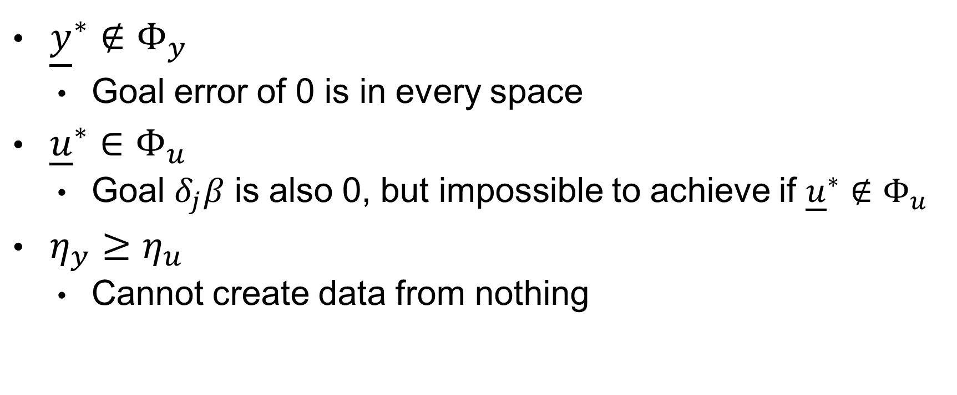
Basis Space Conditions
${\underline{y}}^{∗}∉Φ_{y}$
Goal error of 0 is in every space
${\underline{u}}^{∗}∈Φ_{u}$
Goal $δ_{j}β$ is also 0, but impossible to achieve if ${\underline{u}}^{∗}∉Φ_{u}$
$η_{y}≥η_{u}$
Cannot create data from nothing

Slide 25
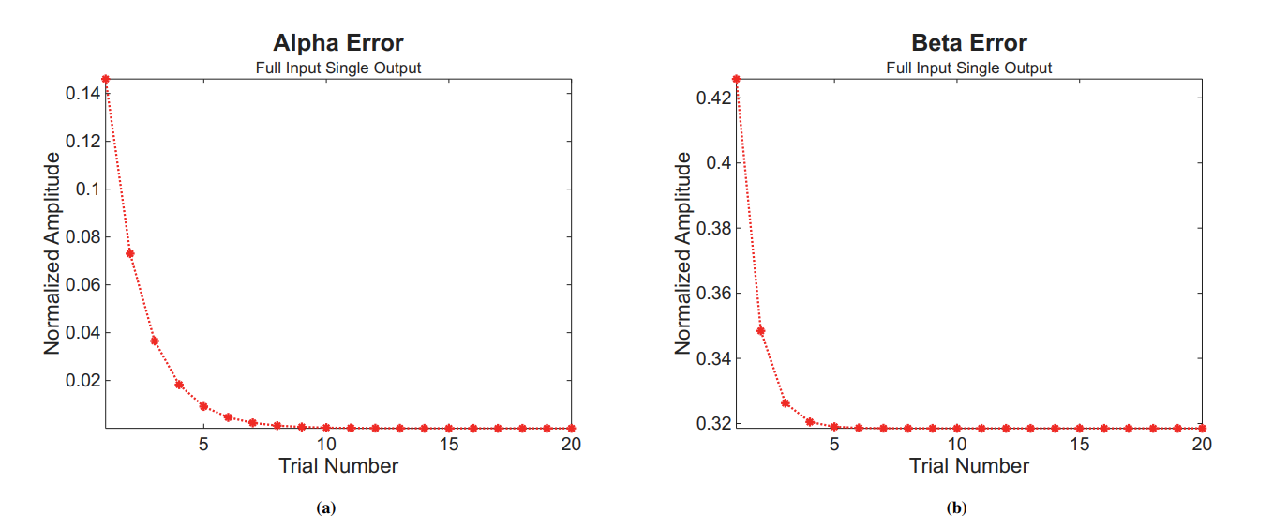
Violated Dimension Conditions

Slide 26
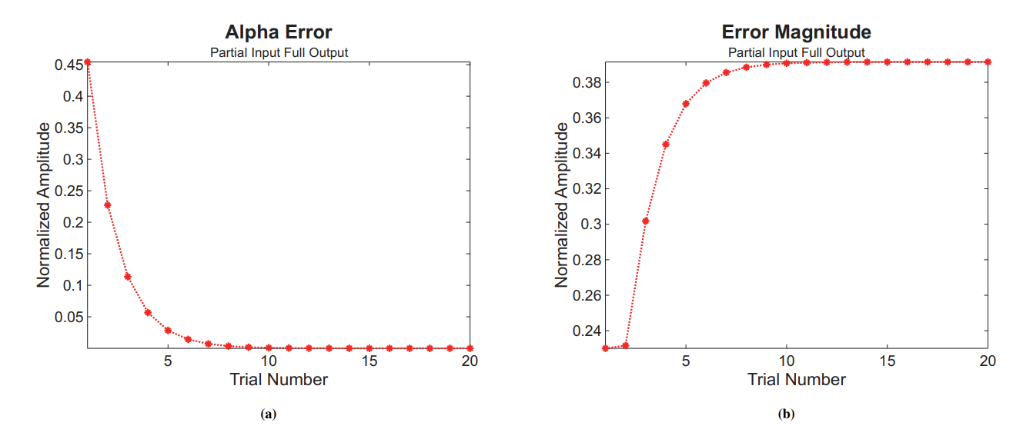

Slide 27
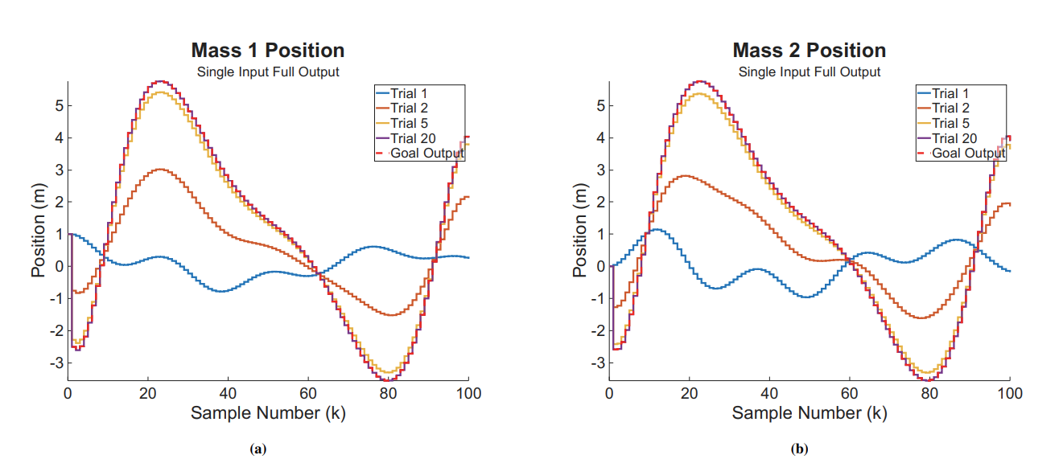
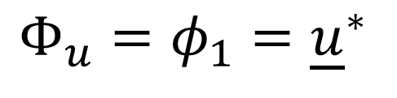
Ideal Scenario
$$Φ_{u}=φ_{1}={\underline{u}}^{∗}$$

Slide 28

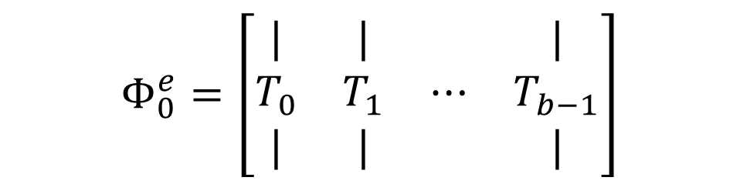
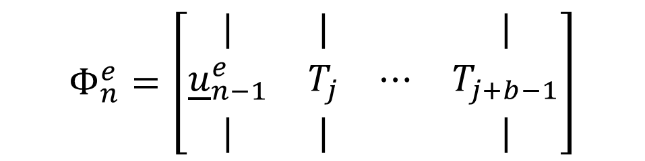
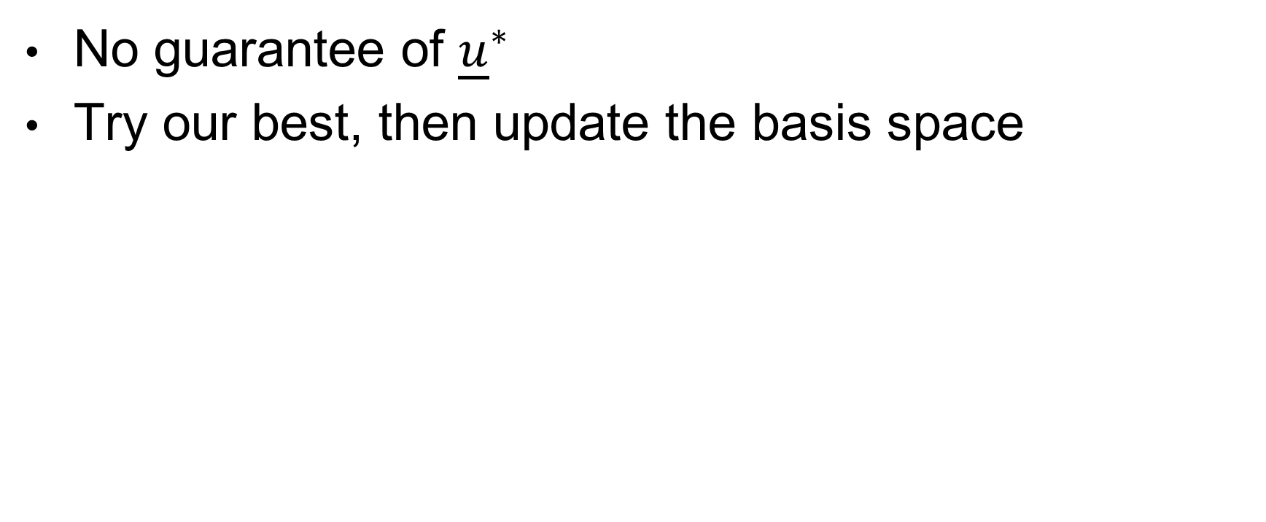

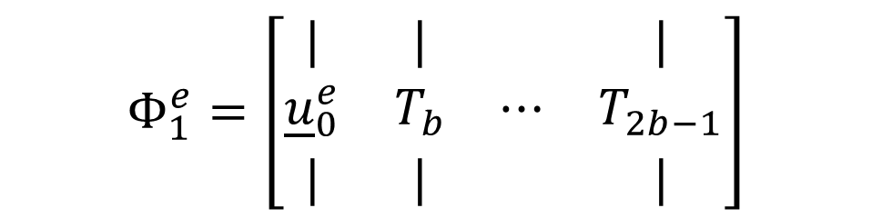

Dynamic Basis Space
No guarantee of ${\underline{u}}^{∗}$
Try our best, then update the basis space
$$Φ_{0}^{e}=\left[\begin{matrix}| & | & & | \\ T_{0} & T_{1} & ⋯ & T_{b−1} \\ | & | & & |\end{matrix}\right]$$
$$Φ_{1}^{e}=\left[\begin{matrix}| & | & & | \\ {\underline{u}}_{0}^{e} & T_{b} & ⋯ & T_{2b−1} \\ | & | & & |\end{matrix}\right]$$
$$Φ_{n}^{e}=\left[\begin{matrix}| & | & & | \\ {\underline{u}}_{n−1}^{e} & T_{j} & ⋯ & T_{j+b−1} \\ | & | & & |\end{matrix}\right]$$
$${{\underline{u}}^{∗}=\underline{u}}_{n}^{e}$$
$${\underline{u}=\underline{u}}_{0}^{e}$$
$${\underline{u}=\underline{u}}_{1}^{e}$$

Slide 29
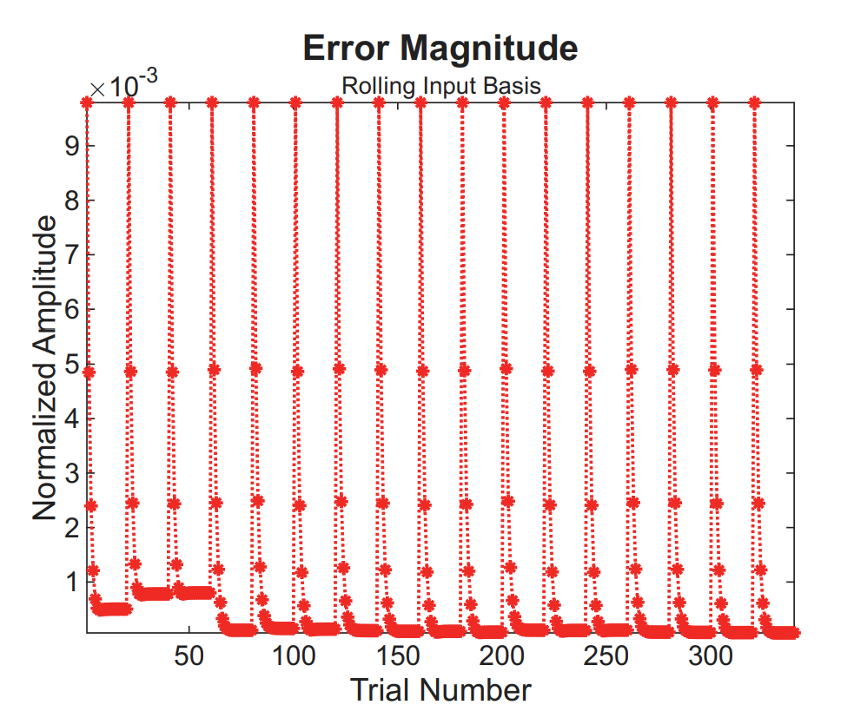
Progression of Errors
Biggest error drop once all basis spaces have been explored
Error minimizes at 0.0132
Not zero

Slide 30
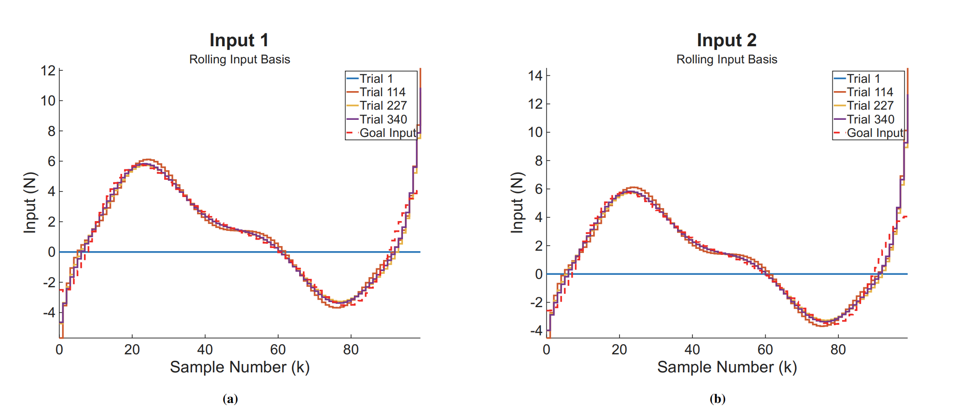

Slide 31
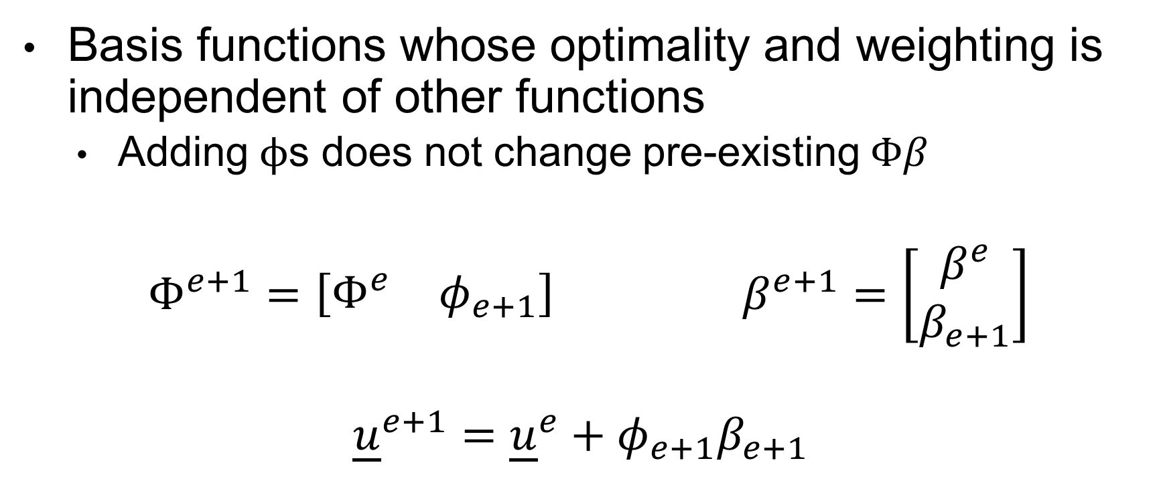
The Hope
Basis functions whose optimality and weighting is independent of other functions
Adding $ϕ$s does not change pre-existing $Φβ$
$Φ^{e+1}=\left[\begin{matrix}Φ^{e} & φ_{e+1}\end{matrix}\right]$ $β^{e+1}=\left[\begin{matrix}β^{e} \\ β_{e+1}\end{matrix}\right]$
$${\underline{u}}^{e+1}={\underline{u}}^{e}+φ_{e+1}β_{e+1}$$

Slide 32
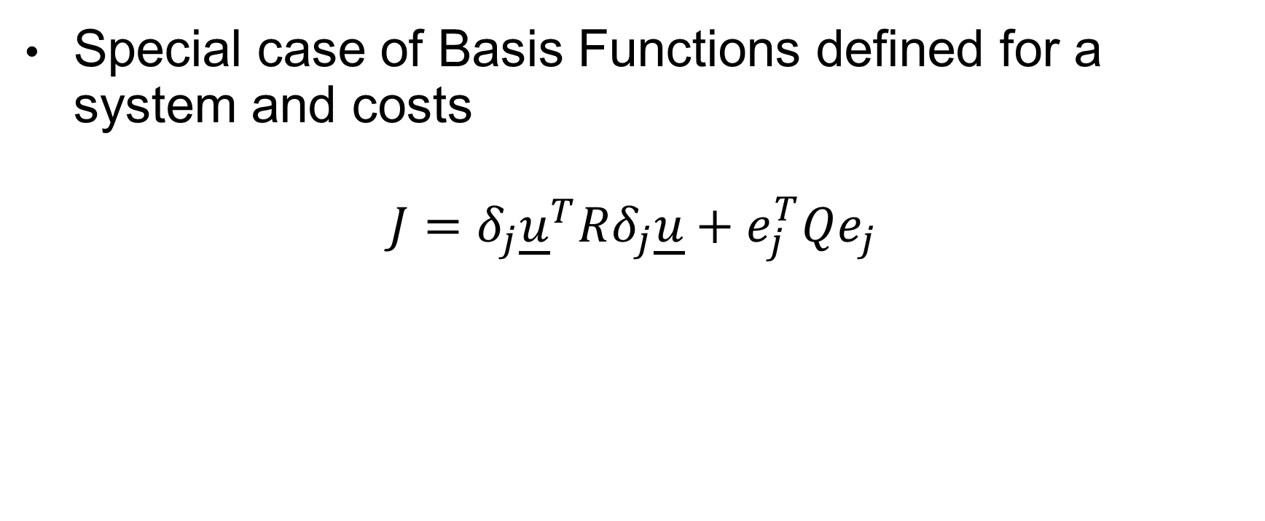
Conjugate Basis Spaces
Special case of Basis Functions defined for a system and costs
$$J=δ_{j}{\underline{u}}^{T}Rδ_{j}\underline{u}+e_{j}^{T}Qe_{j}$$

Slide 33
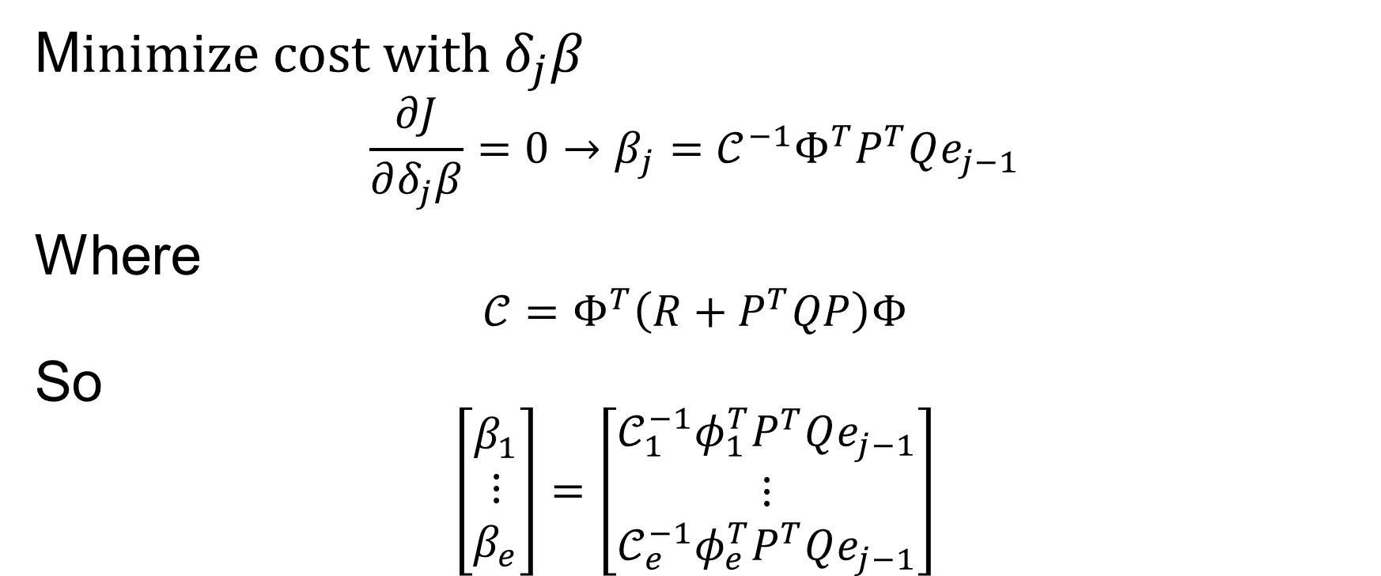

Optimal $δ_{j}β$
M$inimize cost with δ_{j}β$
$$\frac{∂J}{∂δ_{j}β}=0→β_{j}=𝒞^{−1}Φ^{T}P^{T}Qe_{j−1}$$
Where
$$𝒞=Φ^{T}\left(R+P^{T}QP\right)Φ$$
So
$$\left[\begin{matrix}β_{1} \\ ⋮ \\ β_{e}\end{matrix}\right]=\left[\begin{matrix}𝒞_{1}^{−1}φ_{1}^{T}P^{T}Qe_{j−1} \\ ⋮ \\ 𝒞_{e}^{−1}φ_{e}^{T}P^{T}Qe_{j−1}\end{matrix}\right]$$

Slide 34
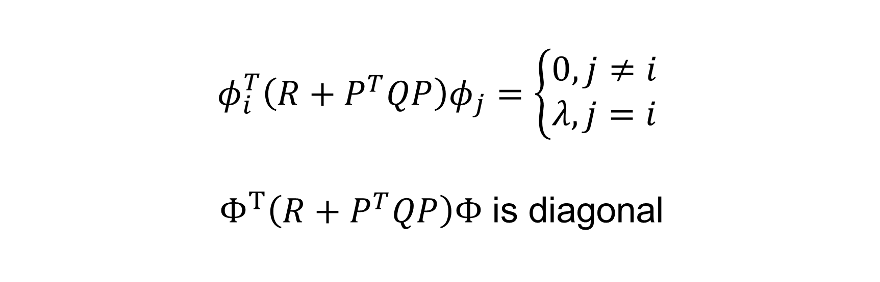
Condition of Conjunctionallity
$$φ_{i}^{T}\left(R+P^{T}QP\right)φ_{j}=\left\{\begin{aligned}0, j≠i \\ λ, j=i\end{aligned}\right.$$
$Φ^{T}\left(R+P^{T}QP\right)Φ$ is diagonal

Slide 35
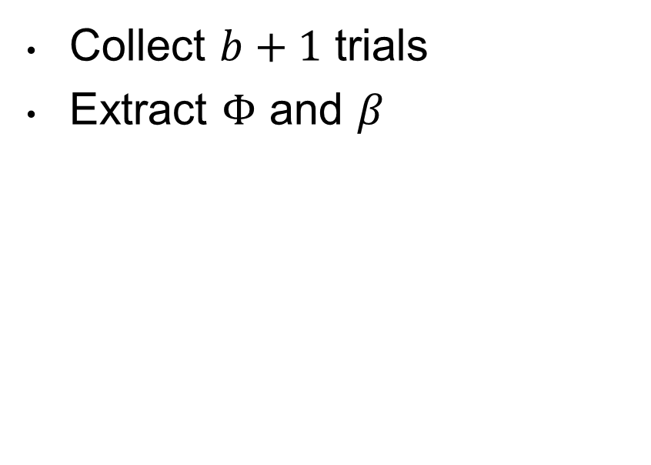

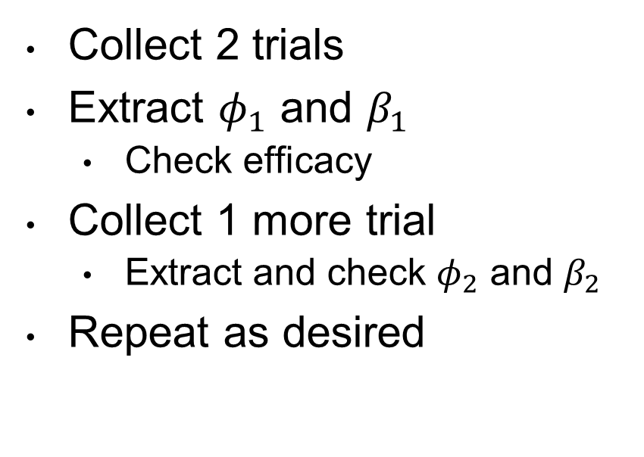
Extracting $Φ$
Batched
Iterative
Collect $b+1$ trials
Extract $Φ$ and $β$
Collect 2 trials
Extract $φ_{1}$ and $β_{1}$
Check efficacy
Collect 1 more trial
Extract and check $φ_{2}$ and $β_{2}$
Repeat as desired

Slide 36
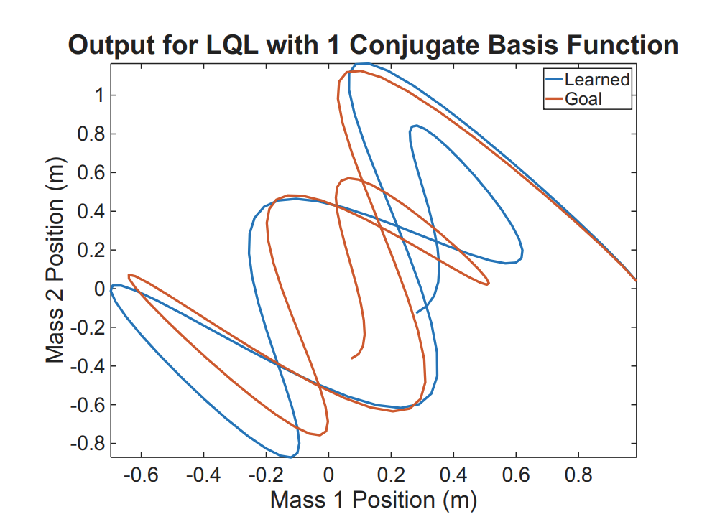
Single Conjugate Basis

Slide 37
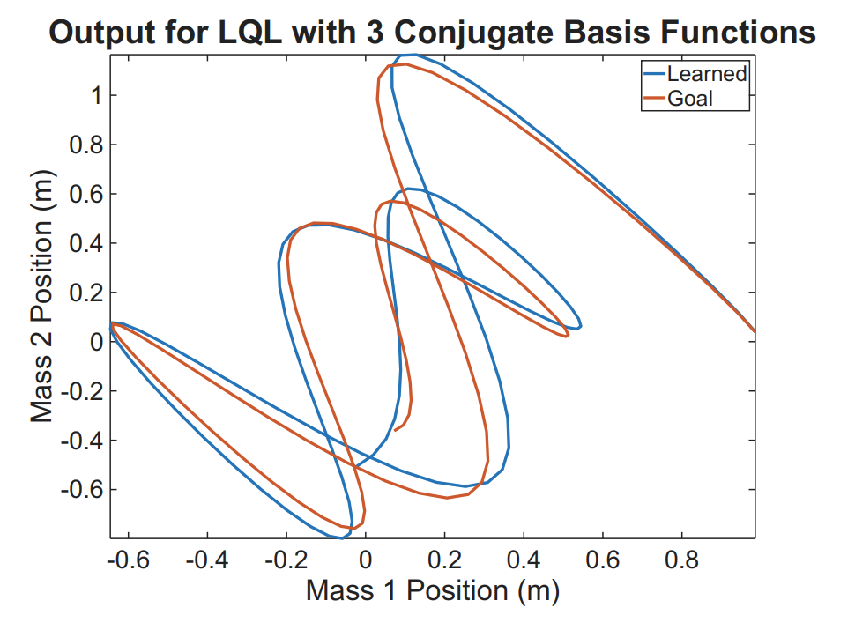
Multiple Conjugate Basis

Slide 38

Sufficient Conjugate Basis

Slide 39
Results

Slide 40

Conjunct Basis Space Controller
Conjunct Property extends to Controllers
$$F^{Φ_{b}}=\left[\begin{matrix}F_{φ_{1}} \\ ⋮ \\ F_{φ_{b}}\end{matrix}\right]$$
$$F^{Φ_{b+1 }}=\left[\begin{matrix}F^{Φ_{b}} \\ F_{φ_{b+1}}\end{matrix}\right]$$

Slide 41


Conditions
Definition of error must be the same for the $F$ to mean the same
Must be properly scaled
Initial $η_{y}$ must be greater than/equal to final $η_{u}$
Cannot be a fixed ${\underline{y}}^{∗}$, despite learning $1×1$ at a time

Slide 42


RL in Fixed Resolution
$η_{y}=20$
${\left(η_{y}+1\right)}^{2}$ collections per controller
Possible to apply previous controllers as new learned

Slide 43


Slide 44
Recommended Application

Slide 45

Optimal Application
Learns optimal input and controller at the same time
Conjugate Basis $β$ gives starting input
$ℒ_{b}$ is learned controller for deviations
Iterative approach allows for stopping once minimized

Slide 46

Choose Dimensions
Select $η_{y}=η_{u}$, know each controller updates in ${\left(η_{y}+1\right)}^{2}$ trials
If after attempting $η_{y}$ basis functions and fail to capture ${\underline{u}}^{∗}$, collapse learned
Keep $Φ_{y}$ fixed by properly combining already learning $φ$s and $F_{φ}$’s

Slide 47
Future Recommendations

Slide 48

Numerical Conditioning
Reduce $R$ without increasing $v(k)$
Scaling of $Φ_{y}$ and $Φ_{u}$
Dynamic $Φ_{y}$ with conjugate basis

Slide 49
Thank you!
Notes:
Thank you slide

Slide 50
Basic Slide
Talking Points

Slide 51
Section Header Slide
Section Subtitle

Slide 52
Two Column Slide
Left Column
Right Column

Slide 53
Comparison Slide
Content A Title
Content B Title

Slide 54
Title Only Slide

Slide 56
Content w/ Caption Slide
Content caption text.

Slide 57
Picture w/ Caption Slide
Picture caption text.

Slide 59
Title Slide
(Dark Option)

Slide 61




Basic Shapes

Slide 62


Slide 63






The ILC System
$$e_{j+1}=Ie_{j}−Pδ_{j+1}\underline{u}$$
$$δ_{j+1}\underline{u}=ℒe_{j}$$
$$200×1$$
$$200×200$$
$$200×1$$
$$200×1$$
$$200×200$$

Slide 64





The ILC System Dimensions
$$e_{j+1}=Ie_{j}−Pδ_{j+1}\underline{u}$$
$$δ_{j+1}\underline{u}=ℒe_{j}$$
$$1000×1$$
$$1000×1000$$
$$1000×1$$
$$1000×1$$
$$1000×1000$$

Slide 65


Slide 66



Input Decoupling
${(4+1)}^{2}$ collections per controller
But need to do $2$ times
5 controllers
20 converged trials
${(n+1)}^{2}$ collections per controller
But need to do $r$ times
5 controllers
20 converged trials

Slide 67


Slide 68


Slide 69
Violated Space Conditions

Slide 70

Basis Dimension Conditions
$η_{y}≥η_{u}$
Cannot create data from nothing

Slide 71

Classical Models
Notes:
From Newton’s Second Law, we could write these coupled equations of motion. However, we find it much easier to express systems in the state-space format

Slide 72

Continuous State-Space
$$\dot{x}\left(t\right)=A_{c}x\left(t\right)+B_{c}u\left(t\right)$$
$$y\left(t\right)=Cx\left(t\right)+Du(t)$$
Notes:
The state space format is as seen above. It communicates how we expect a state ‘x’ to change, given the system matrix Ac, the current state ‘x’, the input matrix Bc, and the applied inputs.
A similar model can be constructed to show our output, y, as a result of current states and inputs as well.

Slide 73

States and Inputs
$x=\left[\begin{matrix}x_{1} \\ x_{2} \\ {\dot{x}}_{1} \\ {\dot{x}}_{2}\end{matrix}\right]$ $u=\left[\begin{matrix}u_{1} \\ u_{2}\end{matrix}\right]$
Notes:
There will be one state for each energy storing element in a system. Our system stores energy as kinetic energy in its two masses, and as potential in its two springs. Thus we will have four states. Inputs are easier – recall we have u1 and u2 on the two masses. Terminology wise, we say n = 4, and r = 2, where n is the number of states and r is the number of inputs.

Slide 74

Open Loop
Notes:
If we start mass 1 displaced 1 meter to the right, and mass 2 moving 2 m/s to the right, we see this behavior. The dampers serve to dissipate the energy

Slide 75

Discrete State-Space
$$x\left(k+1\right)=Ax\left(k\right)+Bu(k)$$
$$y\left(k\right)=Cx\left(k\right)+Du(k)$$
$A=e^{ΔtA_{c}}$ $B=(\int_{0}^{Δt}{e^{αA_{c}}dα)B_{c}}$
Notes:
Our continuous model is computationally impossible to model fairly, however. It implies a continuous calculation over infinitely small time intervals. To fix this, we ‘discretize’ our system matrices such that they are expressed in terms of sample numbers, rather than time. Our output matrices do not need to change

Slide 76

Discrete vs Continuous
Notes:
What this means is while we may not have the same resolution of information, the models match exactly at the time intervals specified. For example, if we discretized our spring-mass system at a rate of 0.01 seconds – meaning we measure states and apply inputs every 0.01 seconds – we can plot these outputs. It can be hard to see here, but if we zoom in:

Slide 77

Discrete vs Continuous
Notes:
We see at every time step that corresponds to a sample number (multiples of 0.01 seconds), the models match exactly. Any system can undergo this process of modeling and discretization

Slide 78

Control
Send all states to zero
System at rest
State-feedback Controller
$$u\left(k\right)=Fx\left(k\right)$$
Places Poles in the Unit Circle
$$x\left(k+1\right)=Ax\left(k\right)+Bu\left(K\right)$$
$$=\left(A+BF\right)x(k)$$
Notes:
Once a system has been modelled, we can then go about controlling it. The simplest definition of control is sending all states to zero – recall for our spring mass system this is logically no masses displaced, with no velocity. A common way to do this is with an r-by-n state-feedback controller, F. What this controller does is for each input, of which we have r, it will compute what it should next be given the present status of the states, of which there is n. Any controller F which places the eigen values of (A+BF) within the unit circle of the complex plane will lead to control. To those of you who that didn’t make sense to, imagine the scalar case. If x(k+1) = x(k) times some constant, so long as the absolute value of the constant is less than one, as k goes to infinity, x(k) will go to zero. Note that if the constant were equal to 1, we would neither achieve control nor would we ‘blow u’ (go to infinity) – matrix-wise that would be on the unit circle boundary

Slide 79

Notes:
Suppose we have a controller that places the poles as seen here. Note they are all within the circle, but relatively far from the origin (‘zero’)

Slide 80

Time to Control
20 samples (0.2 seconds)
60,000 Newtons
Notes:
We can see that if we calculate and apply inputs off of that controller (u=Fx law), within 20 samples we achieve control. However, it requires some extreme inputs of up to 60,000 newtons on input one.

Slide 81

Notes:
Suppose we wanted even faster control – we would design a controller F to place all our poles at the origin

Slide 82

Time Optimal - Deadbeat
2 samples (0.02 seconds)
9,000 Newtons
Notes:
Here we see that complete control is achieved in two time steps. A deadbeat controller, as this is called, is the time optimal solution which will always take a maximum of n steps. See again that we still have some extreme inputs

Slide 83

Linear Quadratic Regulators (LQR)
Cost of States and Inputs
$Q$ and $R$
$$U\left(k\right)=u^{T}\left(k\right)Ru\left(k\right)+x^{T}\left(k\right)Qx(k)$$
Add a discount factor $γ$ for finite time solutions
$$J=\sum_{k=0}^{s}{γ^{k}U(k)}$$
Notes:
To design a controller which takes into account the extreme nature of inputs when seeking control, we turn to the LQR controller. First, we define our matrices Q and R which specify the ‘cost’ of being in a certain state and applying certain inputs, which is a scalar U. The LQR controller will be one such that the path to control, under u=Fx will be the minimum cost solution, or J will be minimized

Slide 84


LQR Application
$$Q=100I_{n×n}$$
$$R=I_{r×r}$$
$$γ=0.8$$
Notes:
The LQR controller designed around these parameters can be shown to exercise control, as all the poles are in the unit circle

Slide 85

Q/R = 100
150 samples (1.5 seconds)
50 Newtons
Notes:
And its application produces these results. Notice how we now need 1.5 seconds to control, but only hit a peak input of 50 newtons

Slide 86


Larger R
$$Q=100I_{n×n}$$
$$R={10I}_{r×r}$$
$$γ=0.8$$
Notes:
If we increase the R weighting, the cost of inputs, we see the poles move closer to the border

Slide 87

Q/R = 10
800 samples (8 seconds)
10 Newtons
Notes:
And now we need 8 seconds to control, but cap out at 10 newtons

Slide 88


Fixed Resolution $Φ_{y}$
Only $Φ_{u}$ matters, but $Φ_{y}$ must be the same for all trials
$Φ_{y}$ can be the identity matrix or conjugates

